Slide 1
QAT Data Model Overview
May 2020

Slide 2
Design Goals
Design to be configurable
Core master data & Reference data control
Design to enable ‘sharing’
Data Standards, API and exchange protocols
Web + Off-line
Design to scale
Modular- Realms
Additional modules added without significant re-engineering

Slide 3
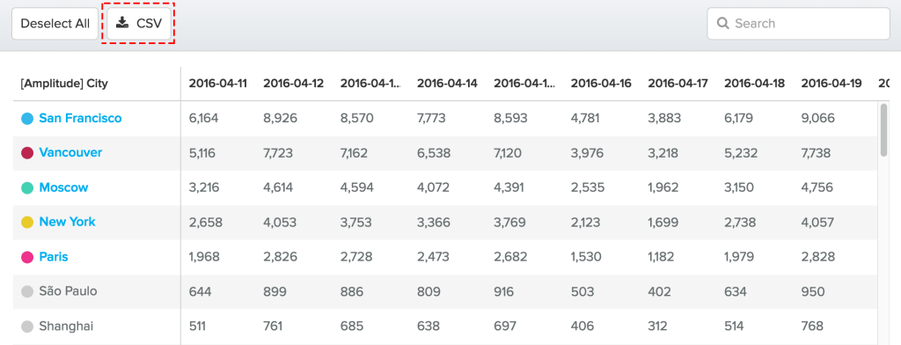

QAT - Framing the Solution
Org
Prod
Country
Region
Health
QAT PLATFORM
PSM-REALM
REALM-3
REALM-2
VISUALIZATION
REALM-1

Slide 4
Creating a Program
Region
Country
Malawi
North+ Central
Master Data
Program
NMCP
Malaria
Reference Data
Organization
Health Area

Slide 5
QAT Module 1
Set -Up
Inputs
Plan
Monitor

Slide 6
QAT Module 1
Set -Up
Inputs
Plan
Monitor
Program
Supplier
Budgets
Currency
Inventory Replenishment
AMC
Lead Times
Products
Inventory
Consumption
Orders
Shipments
Products
Inventory
Consumption
Orders
Shipments
Shipments
Inventory
Consumption

Slide 7



QAT Building blocks “Products”
Forecasting Unit
Planning Unit
Procurement Unit
Notes:
Planning Unit Definition:
Forecasting Unit Def:
Procurement Unit Def:

Slide 8
QAT Building blocks “Expression of Products”
Consumption
Inventory
Orders / Shipments

Slide 9

QAT Building blocks
Inventory Replenishment
AMC
Lead Times
QAT Program
Forecasting Unit
Planning Unit
Procurement Unit
1
N
1
N

Slide 10
QAT Building blocks
Donor,
Price
Budget
Costs
QAT Program
Consumption
Inventory
Orders / Shipments
1
1
1
N

Slide 11
Main ER Diagrams
Product
Inventory, Consumption, Orders, Shipments
Program
Application

Slide 12
Back up

Slide 13
Realms
PSM REALM
Region –
North
South
West
Organization-
MOH
National
Social Mktg-A
Health Area –
HIV
FP
Malaria
VISUALIZATION
Country -
Kenya
Malawi
Zambia
Master Data

Slide 14
QAT Module 1
Set -Up
Inputs
Plan
Monitor
Significantly improved Fundamentals
On-screen + excel+ data imports
Scenarios + versions.
Seamless transition to different data sets
Data interfaces, Data-set exports, Richer Reports

